Slide 1

Lead Scoring – Case study
Srinivasan shanmugasundaram

Slide 2
Project scope
Build logistics regression model
Handle Data issues
Ability to adjust model for future changes.

Slide 3
Data source
Data Set contains leads data from the past (9000 data points) and its data columns are as below
Prospect ID | Specialization | Tags | Page Views Per Visit
Lead Number | How did you hear about X Education | Lead Quality | Last Activity
Lead Origin | What is your current occupation | Update me on Supply Chain Content | Country
Lead Source | What matters most to you in choosing this course | Get updates on DM Content | Digital Advertisement
Do Not Email | Search | Lead Profile | Through Recommendations
Do Not Call | Magazine | City | Receive More Updates About Our Courses
Converted | Newspaper Article | Asymmetrique Activity Index | I agree to pay the amount through cheque
TotalVisits | X Education Forums | Asymmetrique Profile Index | a free copy of Mastering The Interview
Total Time Spent on Website | Newspaper | Asymmetrique Activity Score | Last Notable Activity
 |  | Asymmetrique Profile Score

Slide 4
Assumptions
Column –’Converted’ is the target variable. 0 – indicates not converted and 1 – indicates converted.
Categorical columns has level ‘select’ which is equivalent of NULL values and hence it must be handled.
Build a Logistics Regression model which should have a lead conversion rate of 80% or more.
Assign scores to the leads ( 0 to 100 )

Slide 5
Case study – approach / strategy
Reading and Understanding the data
EDA
Univariate Analysis
Handle Data issues
Visualize
Univariate – Numerical columns
Bivariate – Categorical columns
Data Preparation
Outlier treatment
Binary value conversion
Dummy variable creation
Drop high correlated variables
Train-Test Split
Scaling
Model Building
Select using RFE Technique
Evaluate Models
Prediction
Histogram for numerical columns

Slide 6
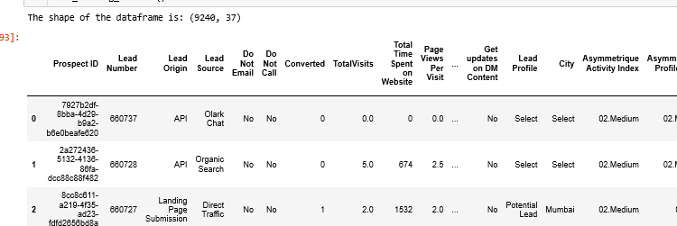
Data Processing – Loading & understanding
Load the source file
Perform basic checks on the loaded to understand its contents
Created a copy of the original data frame so that we do not lose the original data loaded from source
This helps us to perform any data check or data refer at any later point of time
Helps to create multiple copy of data as and when required instead of loading the data every time from source

Slide 7
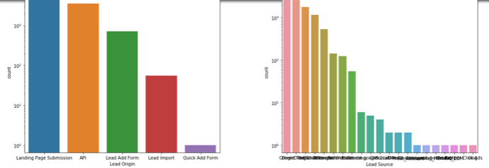
Exploratory data analysis
Check for duplicates
Check for NULL values across all columns
Check data types of columns
Plot the data and check the data distribution

Slide 8
Handle – Data issues
Drop
Drop columns which has only ‘NO’ as unique value
Handle
Handle ‘select’ value in the categorical column by convert all ‘select’ into new levels
Drop
Drop columns which has more than 40% NULL values
Drop
Drop highly skewed ( proportionate of single value is very high ) columns
Drop
Drop rows where value is NULL

Slide 9
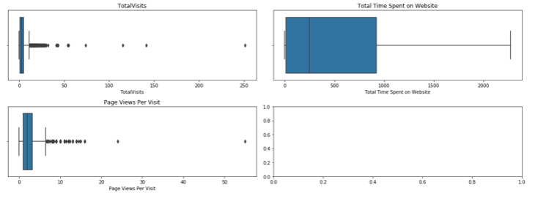
Visualize - Univariate
Do box-plot of data for all the numerical columns
This gives fair idea of the numerical value distribution
Also, it highlights the outlier values

Slide 10
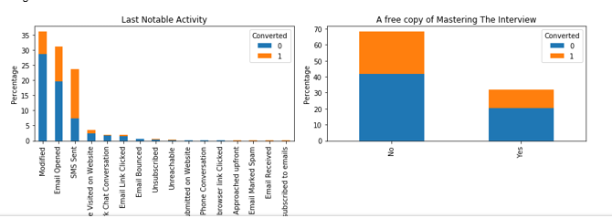
Visualize - bivariate
Perform Bi-variate analysis of all categorical variables against the target variable.
Plot them as bar chart or stacked bar chart to understand the data.

Slide 11
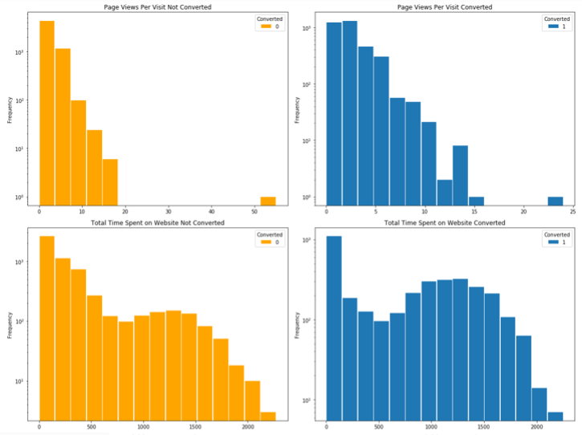
Visualize – histogram
Plot the histogram of data ( Total visits, Total time spent & Page views )
Plot histogram for
Converted – 1and
Converted – 0

Slide 12
Data preparation
Outlier treatment for Numerical columns.
Check the outlier values and drop anything beyond .999 quantile.
Convert the columns which has 2 distinct values into binary ( 0 & 1 ).
Create dummy variables for all categorical values
Identify top 20 highly correlated variables and drop either 1.
Split the data into Train-Test data set.
Scale the data
map({'Yes': 1, "No": 0})
Manually drop the least variable
70% (Train) and 305 (Test)
Standard Scaler

Slide 13
Model building – Initial model
Build initial logistic model using stats library and GLM
Keep all the columns except ( Converted, Lead ID and Prospect ID) as independent variables
Keep Converted as Dependent / Target variable.
Used stats model Binomial family

Slide 14
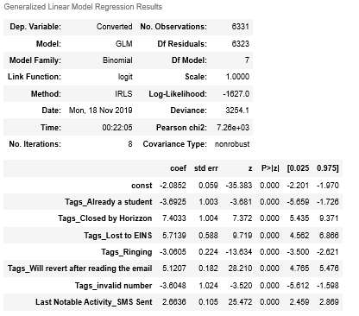
Model evaluation & Tuning
Using RFE technique, I have selected only top 10 variables for building model.
Iterated thrice to drop variables which has high p-value or high negative co-efficient.
Built final model with 7 independent variables.

Slide 15
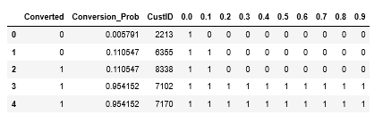
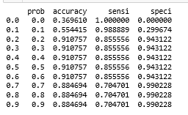
Model evaluation & Tuning CONTD.
Predict the Train Y variable using the final model
Build the probability for different cut offs
Generate the Sensitivity, Specificity & Accuracy for all the ranges.

Slide 16
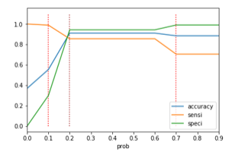
Plot model results
Plot the model results – Sensitivity, Specificity and accuracy along the probability value.
Selected optimum cut-off 0.2 which has Good Sensitivity, Better specificity and accuracy.

Slide 17

Training Data Y-Prediction
Predicted the data for Train.
Achieved accuracy score as 91%
Construct confusion Matrix.
Calculate other performance metrics.
Sensitivity = 0.86
Specificity = 0.94
False positive rate = 0.057
Positive predictive value = 0.90
Negative predictive value = 0.92

Slide 18
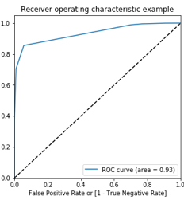
ROC Curve – Training data
Plot the True Negative Rate and True positive rate.
Draw ROC curve to measure the area under the curve. Higher the area, better the model.

Slide 19

Test Data - Prediction
Predict the Y-value of the test data using the final model built using 7 variables.
Measure the overall accuracy score – 90.2 %
Construct the confusion matrix.
Measure other performance metrics
Sensitivity = 0.87
Specificity = 0.93
False positive rate = 0.07
Positive predictive value = 0.89
Negative predictive value = 0.91

Slide 20
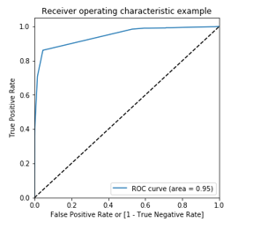
ROC Curve – Test Data
Plot the ROC curve based on the False positive rate and True positive rate

Slide 21
Change in requirements

Slide 22
Increased sales Team
In our previous model, we have selected 0.2 as the optimum cut-off point.
This has resulted in 86% Sensitivity & 94% Specificity.
To handle additional team, must provide additional leads though the leads may not get converted. To cater this need, we can select 0.1 as the cut-off ( as shown ).
This will result in close to 99% Sensitivity & 58% Specificity.

Slide 23
Target achieved reduce useless calls
To handle reduced outgoing calls or useless calls, must provide leads which are positive. This means, we must reduce the negative / false lead. To cater this need, we can select 0.7 as the cut-off ( as shown ).
This will result in close to 99% Specificity and 70% Sensitivity.

Slide 24

Thank You
Vijayapurani L
Srinivasan Shanmugasundaram

